Slide 1


Team members:
Kelton Chesshire, Holden Haile, Abhi Singh
Sponsor:
Skyelar Head
TA:
Sambandh Dhal
Hypoglycemic Center - C₆H₁₂O₆-MATE

Slide 2
Project Description - Background
In the U.S. Alone over 10% of the population suffers from Diabetes. This group has been the inspiration for many devices that make checking blood sugar simple and consistent, but none to help maintain their daily glucose intake.

Slide 3
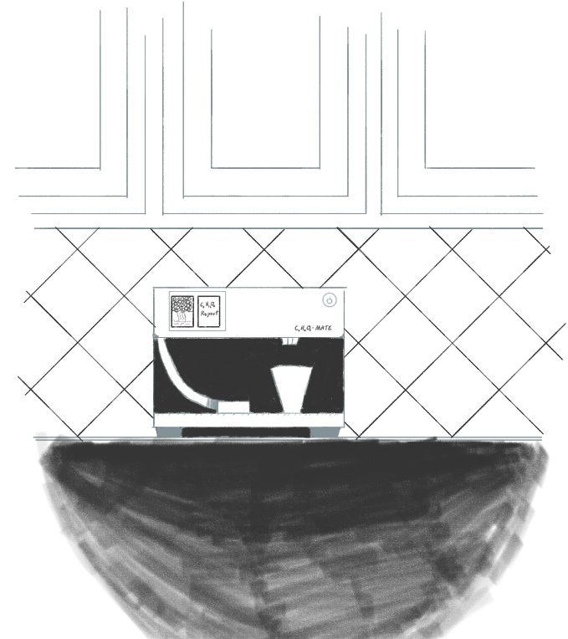
Project Description - Solution Proposal
Develop a device that can accurately dispense carbohydrates in a consistent and easily-consumable manner so that users can accurately manage their glucose levels.

Slide 4
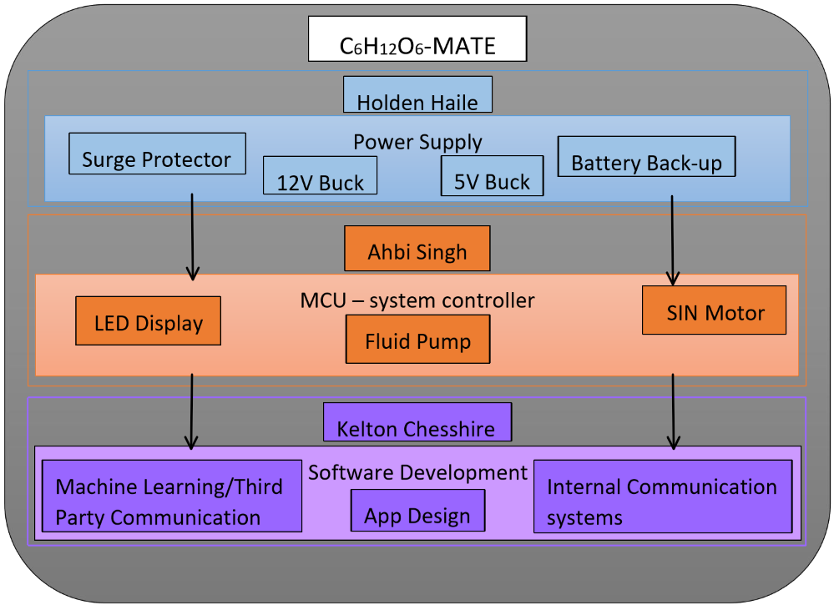
Flow Chart of Subsystems

Slide 5
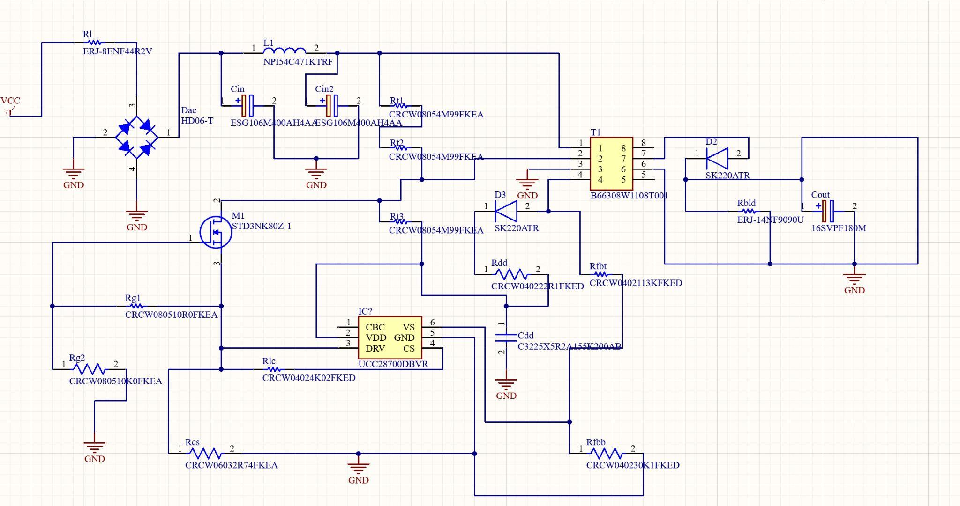
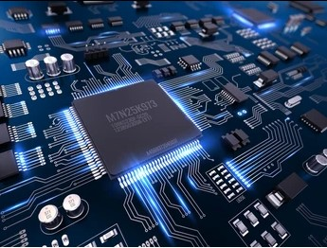
Power Supply: Holden Haile
Consists of:
2 Buck converters
1 x (12V, 4W) to 1 output
1 x (5V, 7.5W) to 3 outputs
Surge Protector
Battery Backup
Image from Shudderstock.com

Slide 6
Dispensing System & MCU: Abhi Singh
Dispensing System
Skittle Dispenser
Juice Dispenser
Onboard User Interface
Touch Screen Display
Communicates with MCU
MCU
Connected via WiFi/Bluetooth to our backend which enables us to automatically dispense and alert.

Slide 7


Application & Machine Learning: Kelton Chesshire
Consists of:
Application Frontend & UI Design
Expo/Native React
Application Backend
Firebase & Express.js
Communication Protocols
WiFi Communication
Bluetooth Communication
Machine Learning

Slide 8
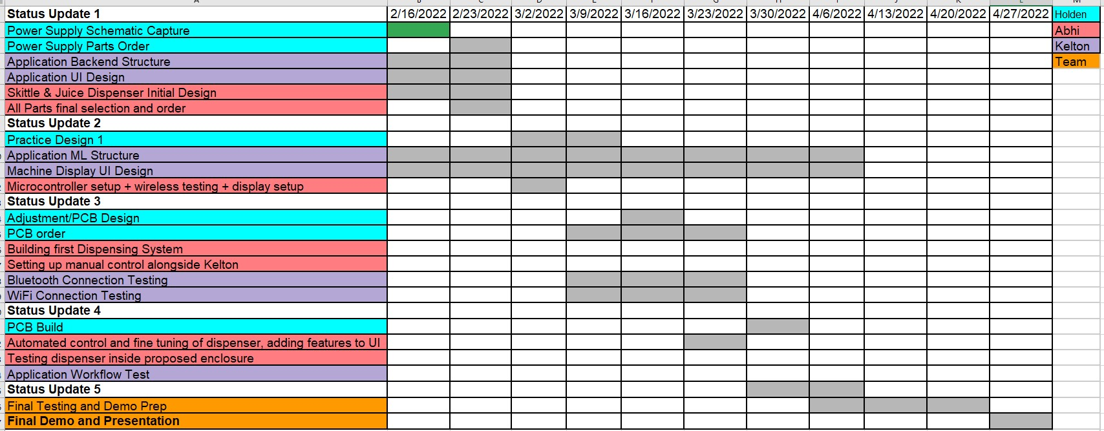
Execution plan

Slide 9
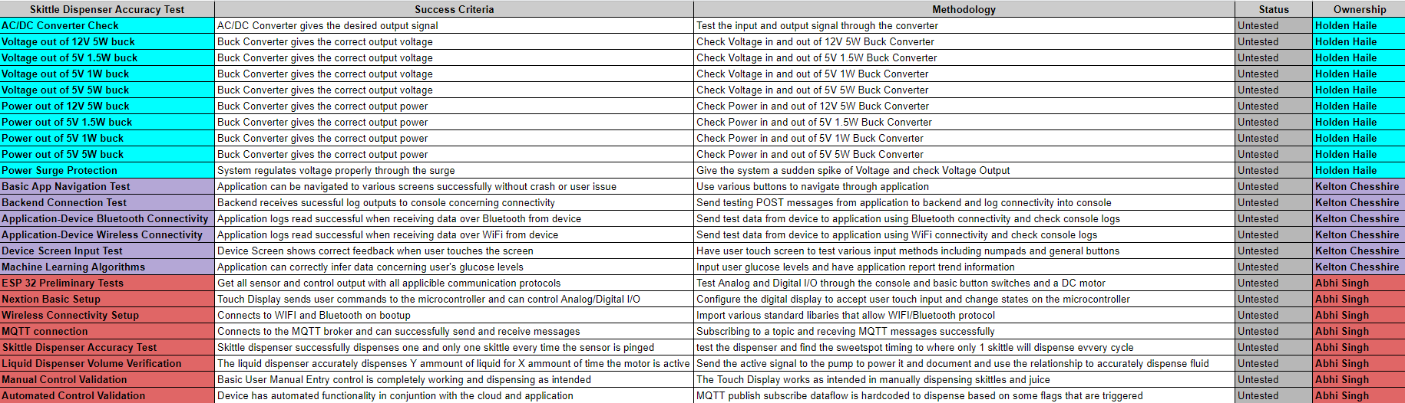
Validation plan

Slide 10
Part order status
part description | Status (order approved/order placed/part received)
Raspberry Pi x 2 | Part Received
Arduino Nano | Part Received
Test Phone | Part Received
Peristaltic Liquid Pump | Not Ordered Yet

